Slide 1
Team Fowler
-Casey Adams -Michael Voorhies -Anthony Ganster -Dominic Perrine

Slide 2
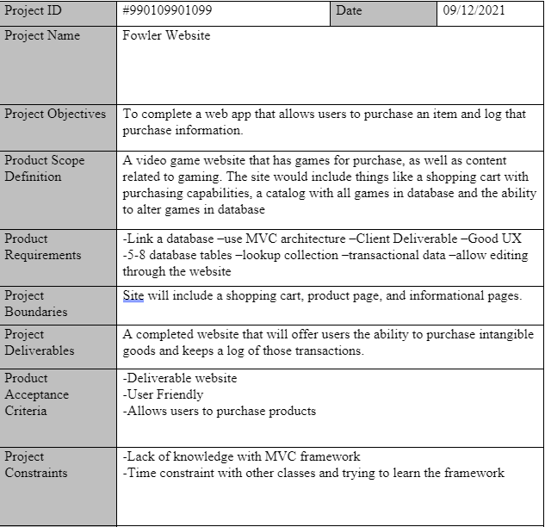
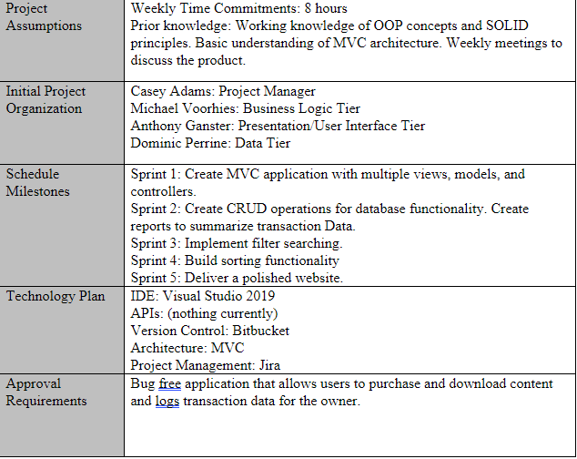

Slide 3
Sprint One
Goals:
Initial UI with database and dynamic elements.
Contacts and products pages

Slide 4
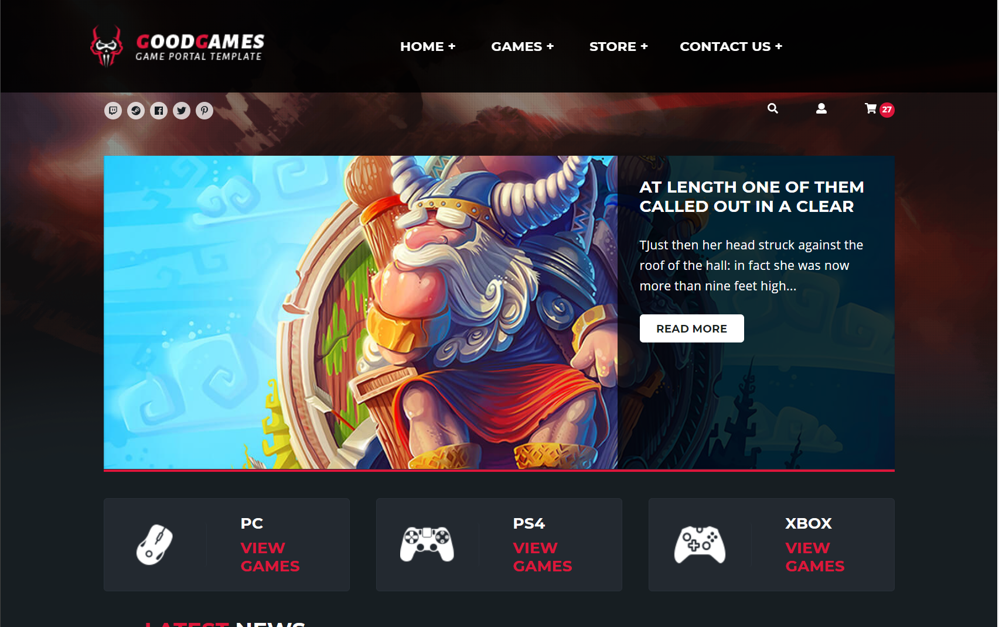
Live Demo

Slide 5
Questions?

